Slide 1
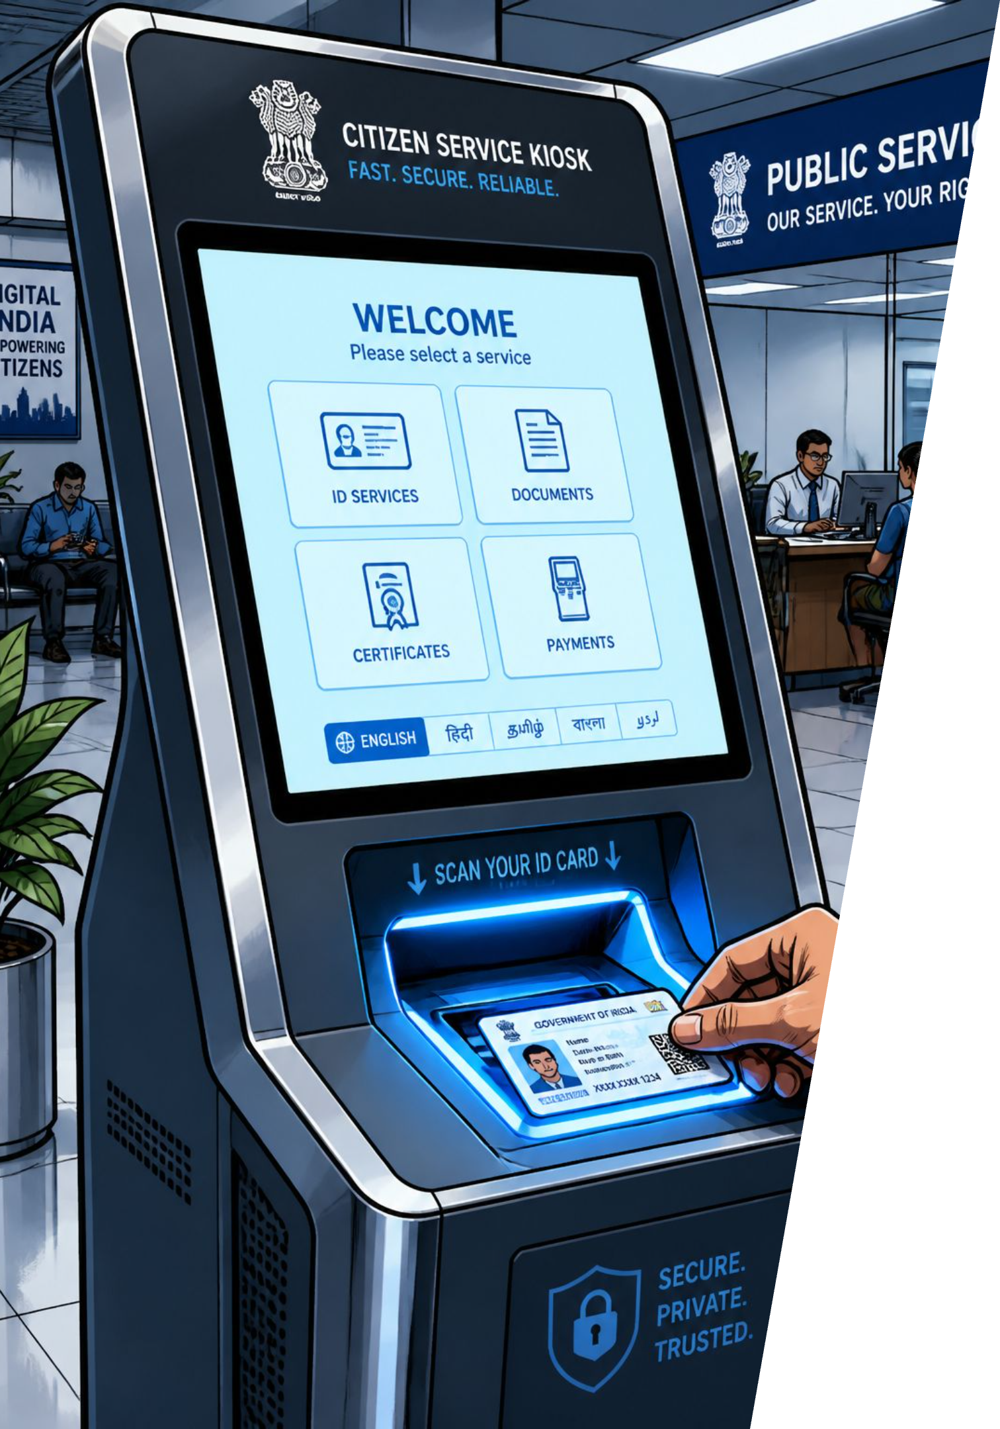
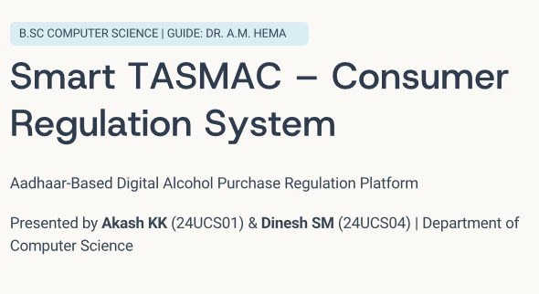
Smart TASMAC — Consumer Regulation System
Aadhaar-linked digital platform to regulate alcohol purchases — college final year project by Akash KK (B.Sc Computer Science). Academic Year 2025–2026. Guide: Faculty Name, Dept. of Computer Science.

Slide 2

Problem Statement
No Identity Verification
Underage & Unlimited Buying
Purchases occur without Aadhaar or reliable ID checks.
Minors can buy alcohol and consumers face no limits.
No Monitoring or Analytics
Lack of Transparency
No purchase history, doctor restrictions, family monitoring, or real-time government analytics.
Manual reporting and absence of digital audit reduce accountability.

Slide 3
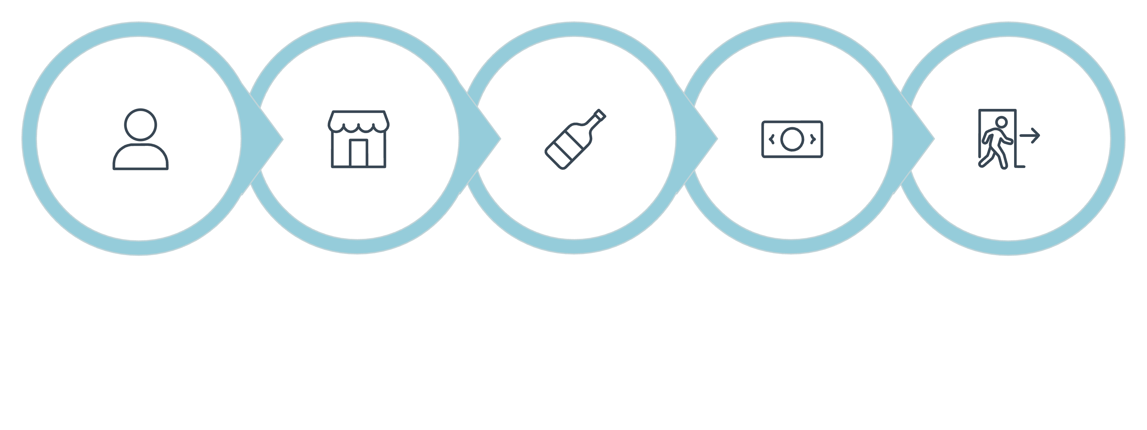
Existing System — Workflow
Cash Payment
Customer
Visit Shop
Buy Alcohol
Leave
The current TASMAC retail workflow lacks digital identity checks, audit trails, health monitoring, purchase limits, and government analytics.

Slide 4

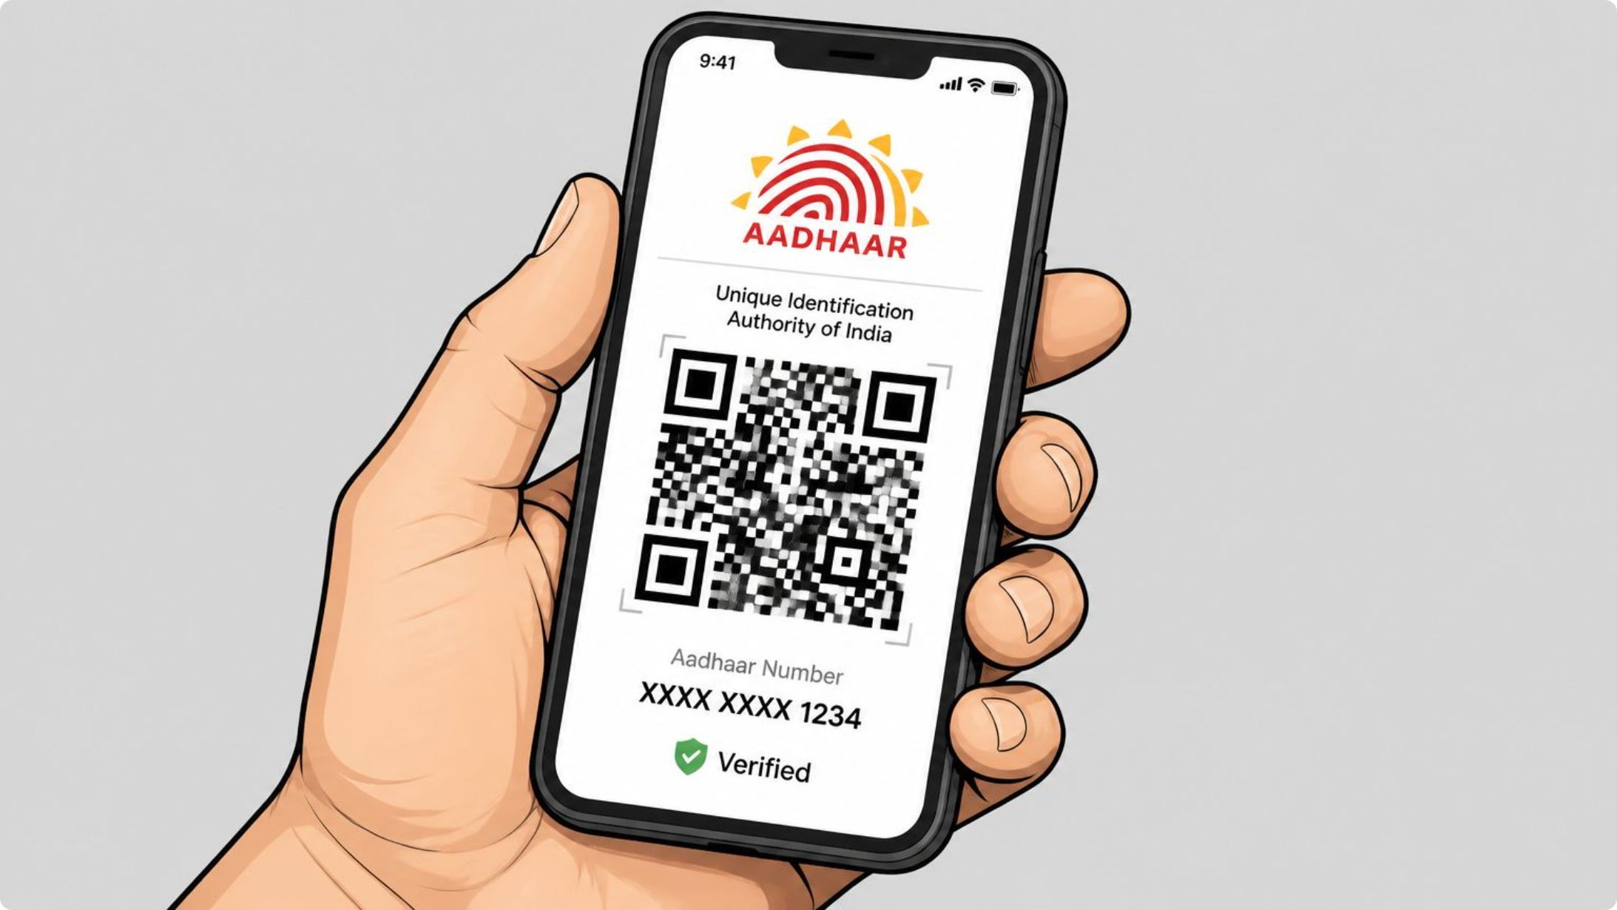



Proposed Solution Overview
Aadhaar Registration
Secure, verified consumer identities.
QR Code Identity
Quick in-shop verification.
Purchase Limits
Enforce consumption caps
per consumer.
Doctor Restrictions
Medical professionals can
restrict purchases.

Slide 5
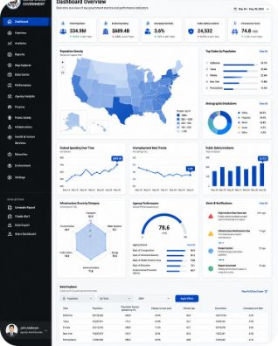
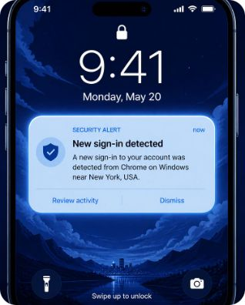

Features & Benefits
Government Dashboard
Notifications & Digital Audit
Caretaker Monitoring
Real-time analytics and reports for policy and enforcement.
Automated alerts and maintainable purchase history (PDF reports).
Family members can supervise and enable teetotaler mode.

Slide 6

Project Objectives
Prevent Underage Purchase
Identity verification blocks minors.
Regulate Consumption
Purchase limits and teetotaler options promote responsibility.
Support Healthcare
Doctors can restrict patients as needed.
Transparency & Reporting
Digital audit trails and government reports improve oversight.

Slide 7

Stack: React frontend, FastAPI backend, JWT for security, PostgreSQL storage, QR code generation, and PDF reporting for audits.
System Architecture
Government dashboard
Consumer
Regulatory interface
User on mobile device
PostgreSQL database
Technology Flow
React frontend
Interactive UI and QR
handling
Persistent storage
JWT authentication
FastAPI backend
API layer and business logic
Secure token-based auth

Slide 8




Core Modules
Consumer Module
Aadhaar registration, QR, purchase history, limits, notifications, PDF/health reports, teetotaler mode.
Government Admin Module
Shop Operator Module
Dashboards, analytics, reports, policy enforcement tools.
Login, QR scan, verify eligibility, sell products, sales history.
Doctor & Caretaker Modules
Medical restrictions, family monitoring, support workflows.

Slide 9
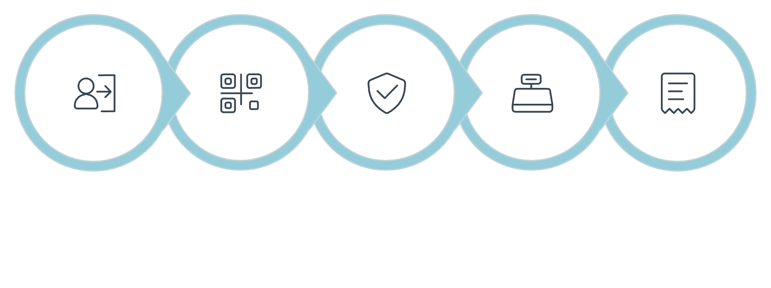

Shop & Doctor Workflows
Verify Eligibility
Record Transaction
Authenticate
Set Restriction
Enforce Block
Notify Caretaker
Login
Scan QR
Process Sale
Both workflows integrate with the central backend to enforce limits and update audit logs in real time.

Slide 10

Next Steps & Implementation Plan
01
Prototype
Build React UI, FastAPI endpoints, and QR integration.
02
Integration
Connect Aadhaar verification, JWT auth, and PostgreSQL storage.

Slide 11
Key Smart Features
Aadhaar Verification
QR Code Purchase
Daily Purchase Limit
Weekly Limit
Monthly Limit
Doctor Restriction
Caretaker Monitoring
Notifications
PDF Reports
Audit Trail
Smart TASMAC offers a comprehensive suite of features to ensure responsible alcohol regulation, from identity verification to detailed analytics and medical oversight.

